Slide 1
Glycosides
University of Basrah
Pharmacy college
Department of pharmacognosy
Ass. Lecturer Riham Adnan

Slide 2
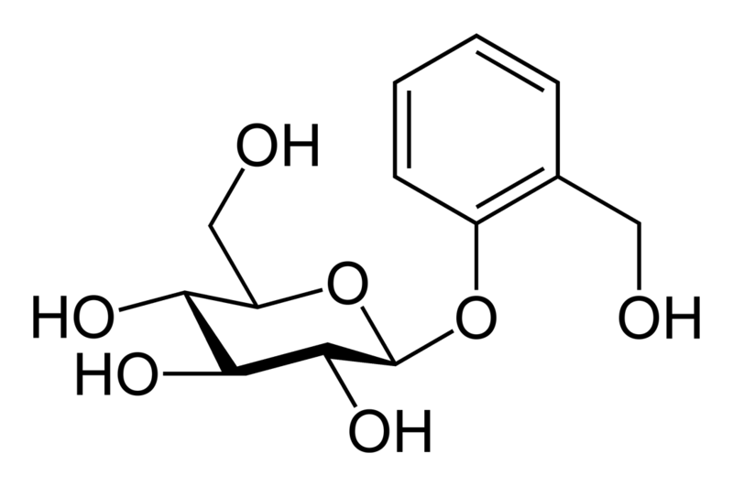
Glycosides
Aglycon (genin)
Glycon
(saccharide)
Glycosidic bond

Slide 3
Glycosides
Aglycon (genin)
Glycon
(saccharide)
Glycosidic bond

Slide 4
Glycosides
Are organic compounds , secondary metabolites, usually of plant origin, that are composed of sugar portion (called glycon or saccharide) bound to non-sugar portion (called the aglycon or genin) through glycosidic bond.
Upon glycoside hydrolysis we get one or more sugar molecule and an organic hydroxide.

Slide 5
Glycosides
General properties:
1- they are water soluble
2- colorless (except flavonoids-yellow, anthraquinone-red)
3- odorless (except glycyrrhizin)
4- most of them posses bitter taste (except: eg: glycyrrhizin….give another example ???)
4- the glycosidic bond is hydrolysable by mineral acids+temperature or enzymes

Slide 6
Glycosides
Types
Based on the atom involved in glycosidic linkage between the glycon and the aglycon part
O- glycosides
C- glycosides
N-glycosides
S- glycosides

Slide 7
Glycosides
Aglycon (genin)
Glycon
(saccharide)
Glycosidic bond

Slide 8
Glycosides
Types
Based on the type of glycon part within the glycoside
Eg;
Glucoside (the glycon is glucose)
Mannoside (the glycon is mannose)

Slide 9
Glycosides
Types
Based on the number of monosaccharides in the glycon part
Eg;
Monoside (one monosaccharide)
Biosides (two monosaccharides)
Triosides (three mono saccharides)

Slide 10
Glycosides
Types
Based on the type of aglycon part within the glycoside
Eg:
Flavonoid glycosides
Saponin glycosides
Anthraquinone glycosides
Cardiac glycosides
Aldehyde glycosides

Slide 11
Glycosides
Types
Based on the type of aglycon part within the glycoside
Eg:
Flavonoid glycosides
Saponin glycosides
Anthraquinone glycosides
Cardiac glycosides
Aldehyde glycosides
Did you know?
Vanillin is a common type of glycosides

Slide 12
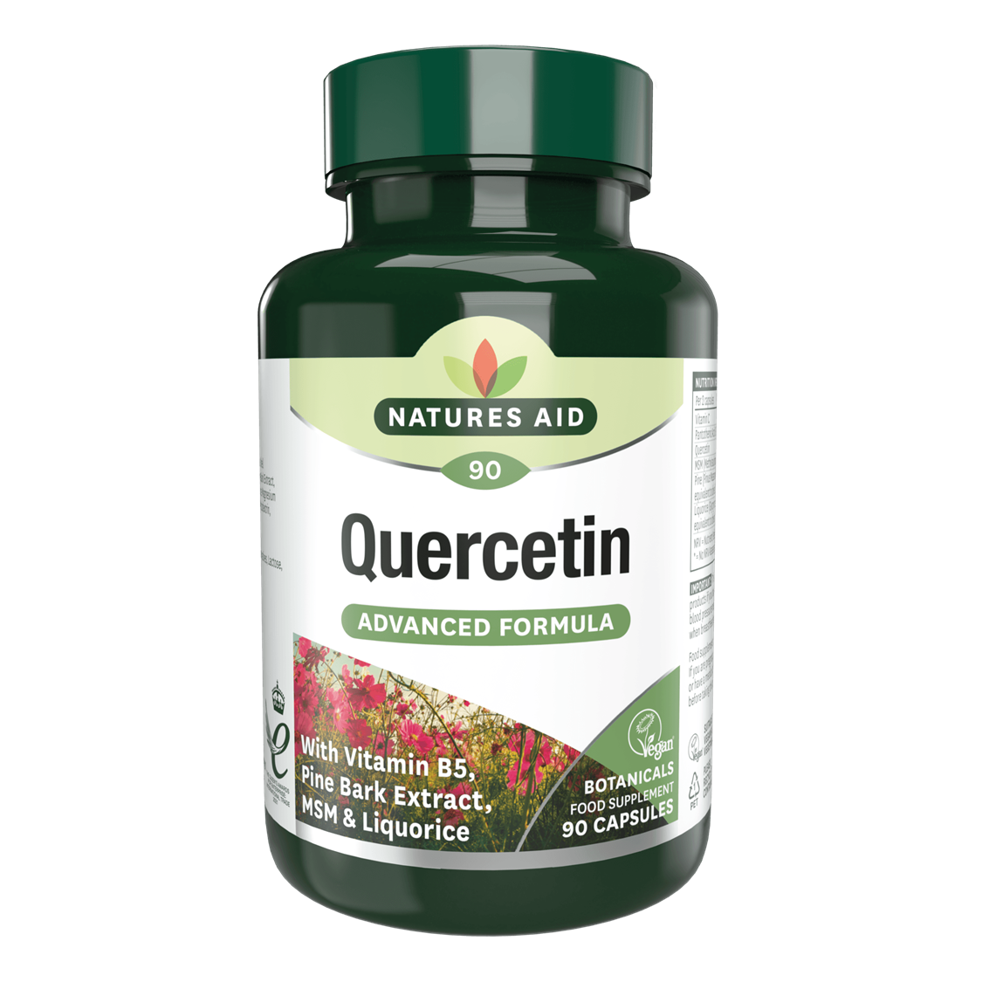
Glycosides
Flavonoid glycosides
Flavonoids
Is a Group of polyphenolic compound that posses flavan nucleus within their chemical structure
Flavus = yellow (although some are colourless)
Present within fruits ,vegetables, seeds and flowers

Slide 13
Flavonoid glycosides
Medicinal benefits
Antioxidants and anti-inflammatory
Regular consumption reduces risk of several chronic diseases such as cancers and neurodegenerative disorders.

Slide 14
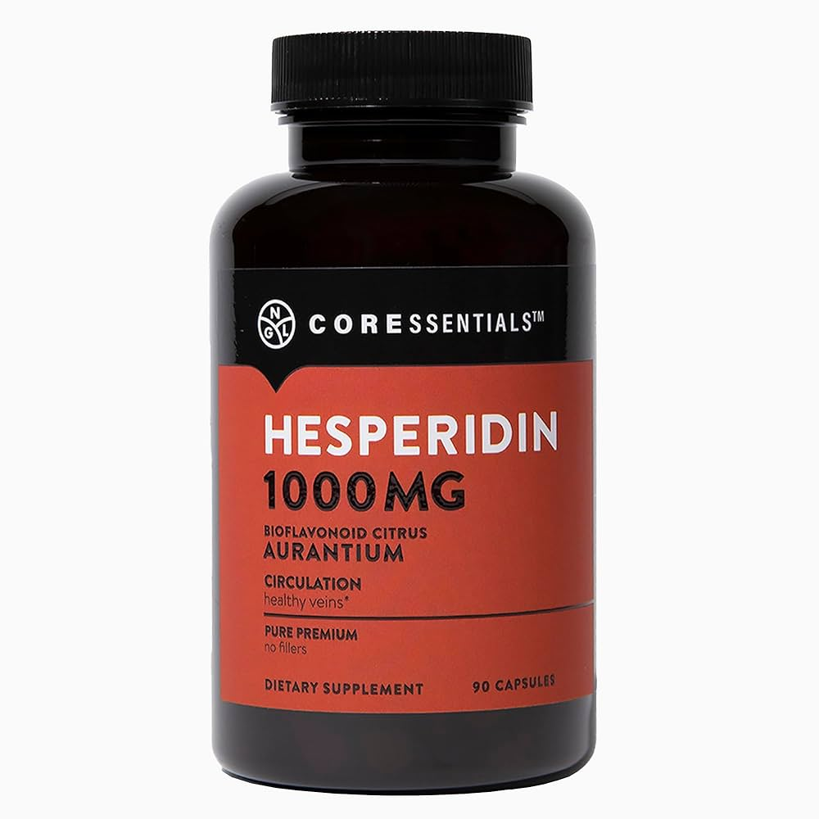
Flavonoid glycosides
Medicinal benefits
Antioxidants and anti-inflammatory
Regular consumption reduces risk of several chronic diseases such as cancers and neurodegenerative disorders.

Slide 15
Flavonoid glycosides
Medicinal benefits
Antioxidants and anti-inflammatory
Regular consumption reduces risk of several chronic diseases such as cancers and neurodegenerative disorders.

Slide 16
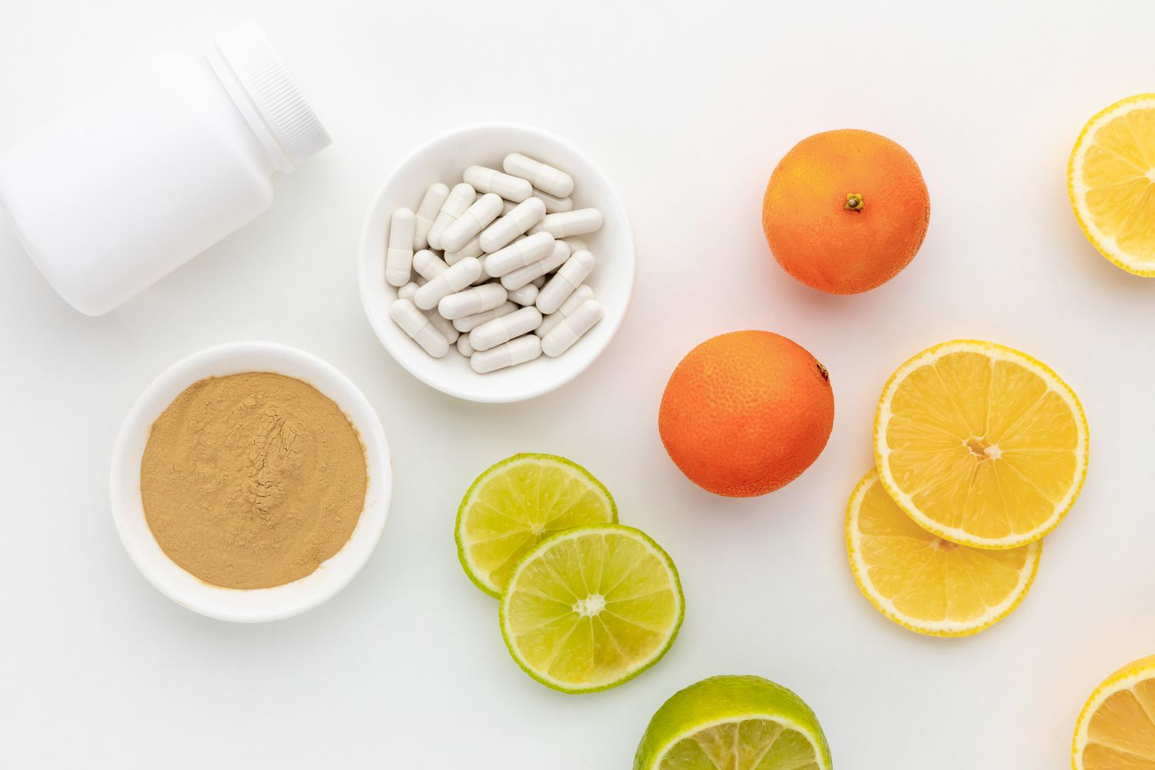
Flavonoid glycosides
Hesperidin, a polyphenolic bioflavonoid, is the predominant flavonoid in orange peel and other citrus fruits, with the highest concentration being found in the white parts and pulps of the citrus peels. Hesperidin can also be found in green vegetables

Slide 17
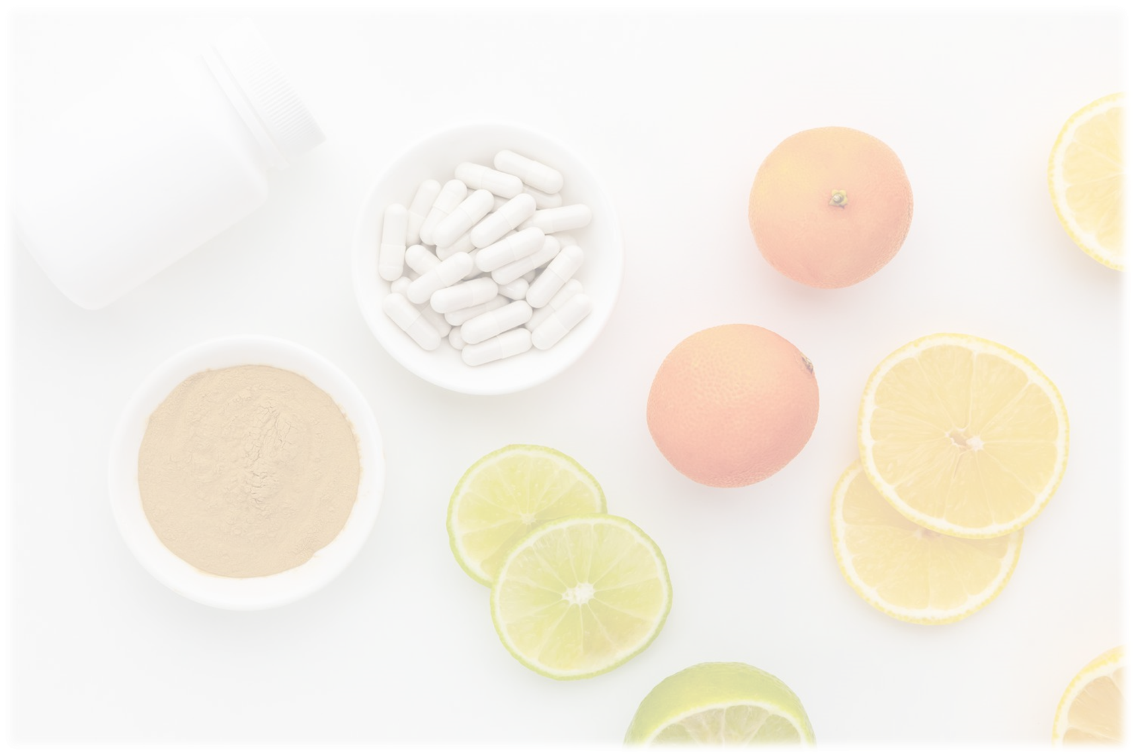
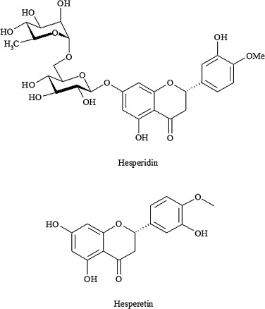
Glycosides
Flavonoid glycosides
Within the hesperidin (flavonone)
Hesperitin….. (aglycon)
Disaccharide rutinose….. (glycon)

Slide 18
Glycosides
Flavonoid glycosides
The sugar causes hesperidin to be more soluble than hesperitin.
Hesperidin is an antioxidant that enhances the action of vitamin C to lower cholesterol levels.
It is also known to have pharmacological action as an anti-inflammatory, antihistaminic, and antiviral agent.

Slide 19
Flavonoid glycosides
Extraction Procedure
Hesperidin can be isolated by 2 methods :
Conventional method :the dried orange peel (250 gm) were macerated well with 800 ml of methanol overnight the filter, collect the filterate for detection of hesperidine.
Modern method: by using soxholet apparatus and petroleum ether as solvent.

Slide 20
Flavonoid glycosides
Detection of flavonoid
FeCl3 test: 1 ml extract + few drops of FeCl3 (10%)→ brown color solution
Lead acetate test: 1 ml extract + 10 drops of lead acetate (10%)→ white precipitate
Sodium hydroxide test: 1 ml extract + 5 drops NaOH (10%) →yellow color solution appear, which disappear upon addition of 5 drops HCl
Shinoda test : 1 ml extract + 5 drops HCl + few crystals of Magnesium metal→ pink color solution

Slide 21
Note
Next lab you will have technique evaluation

